Slide 1
GWAS using Espresso/SAT methods

Slide 2
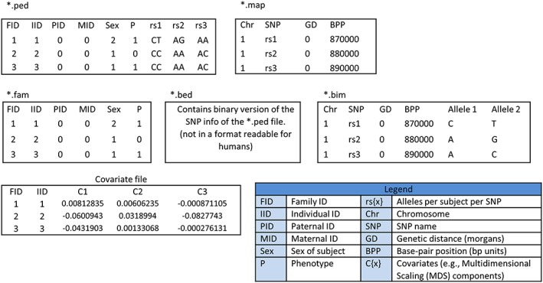
Data

Slide 3
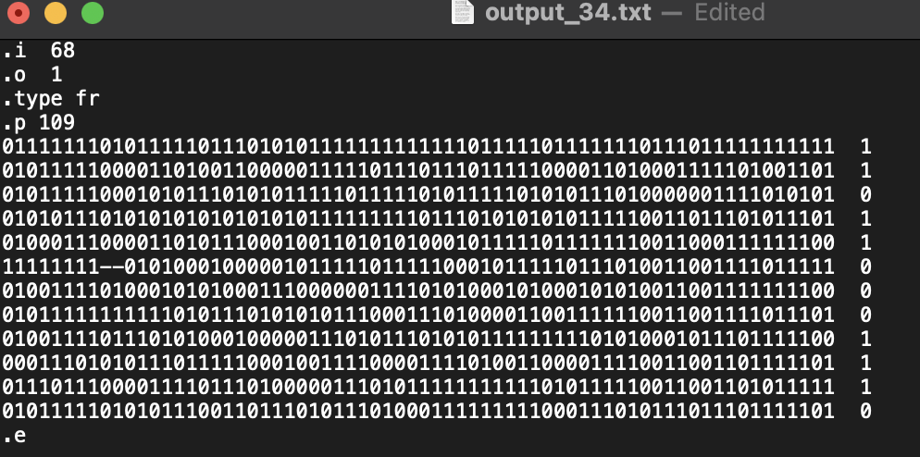
Espresso
Heuristics
Minimal cover
AB’CD+A’B

Slide 4
Pairwise consideration
AA 11
Aa 01
aA 01
aa 00
00 --

Slide 5
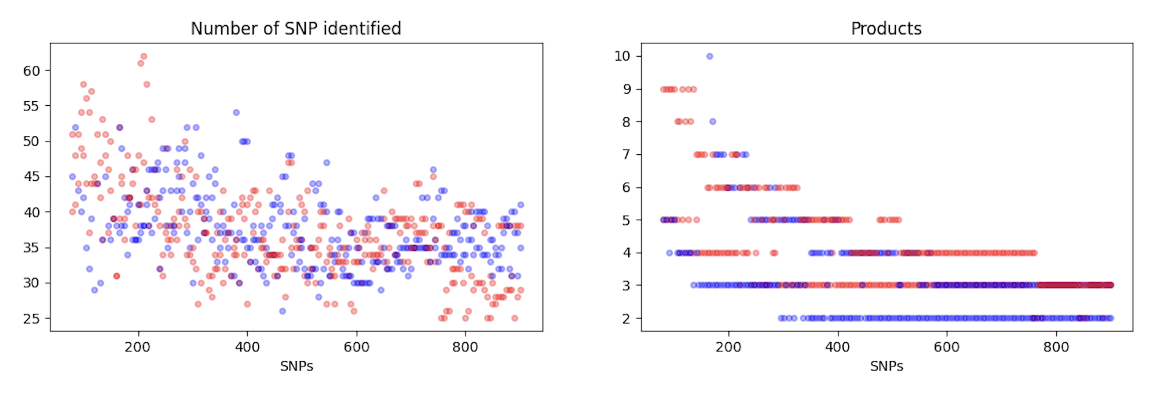
Experiments
Fixed sizes

Slide 6
Combination
ACGTCDIGACACGACGTACGTACGTCDIGACACGTCDIG
ACCDIGACCDIGACTCGAC
CDACTCG

Slide 7
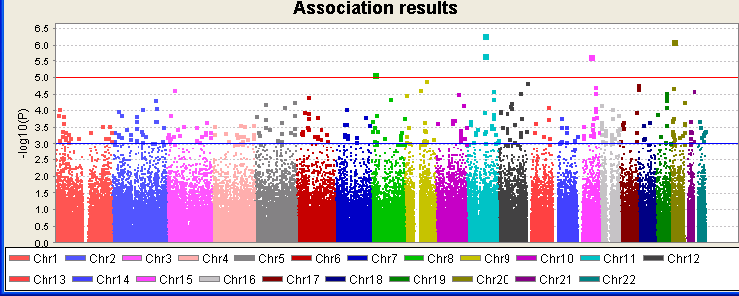
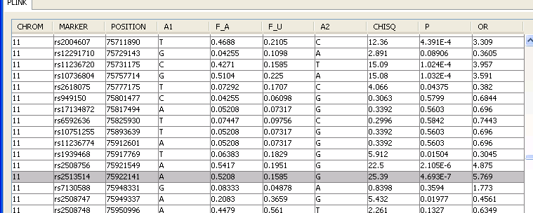
PRS
Principal components to model phenotype

Slide 8
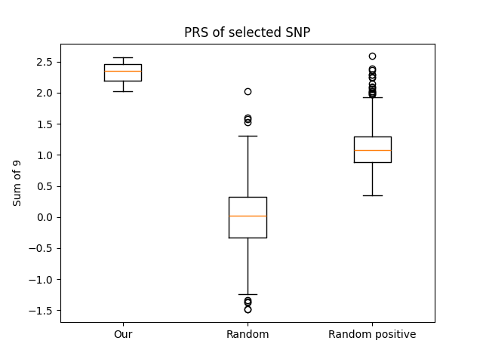
Sum of 9 SNPS
Better selection than random
Not the best possible
Starting f

Slide 9
Data format

Slide 10
Questions
Statistical analysis
How many literals/products are a “good” result?

Slide 11
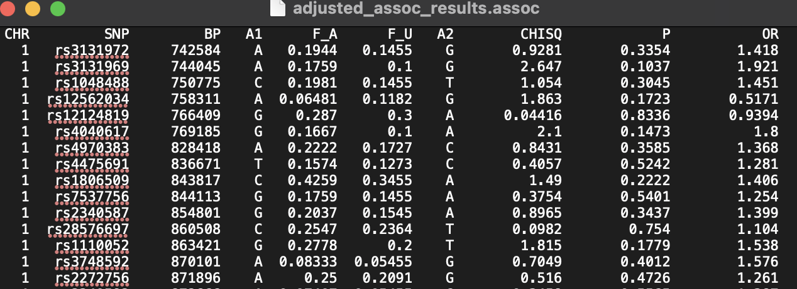
Association file
How to calculate?

